Slide 1








Organisational Life Assistant (OLA)
For future active ageing

Slide 2
Partners Involved
Microsoft Portugal (MLDC) – Portugal [Coordinator]
Knowledge Society Association (SSW) - Poland
Bay Zoltán Nonprofit Ltd. For Applied Research (BZN) - Hungary
ISCTE – University Institute of Lisbon - Portugal
Comfort Keepers – Confort at Home, Lda. (CKPT) - Portugal
Liquid Media AB (LM) - Sweden

Slide 3
Table of contents
Organisational Life assistant
Project Objectives
Motivations and the main challenge
Environment Analysis
Pipeline
Gamification
Questions
Tiago Pedro | ISCTE-IUL, ISTAR-IUL
DCC’16 – Games for Design Research and Education
25th June 2016

Slide 4
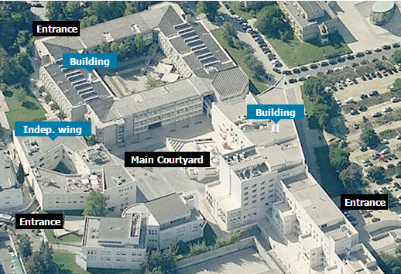
Iscte-iul
ISCTE-Instituto Universitário de Lisboa
Located in the center of Lisbon, covers many fields of knowledge integrating the following schools:
ISCTE Business School
School of Sociology and Public Policy
School of Social Sciences
School of Technology and Architecture
Tiago Pedro | ISCTE-IUL, ISTAR-IUL
DCC’16 – Games for Design Research and Education
25th June 2016

Slide 5
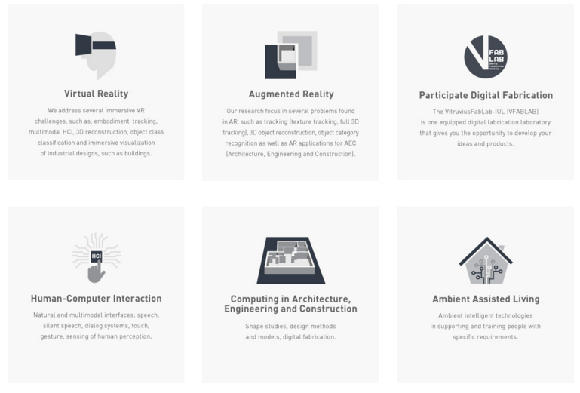
DLS – ISTAR-iul
Digital Living Spaces (DLS) is a research group of ISTAR-IUL (Information Science, Technologies and Architecture Research) that focuses on the following areas of knowledge:
Virtual Reality
Augmented Reality
Participate Digital Fabrication
Human-Computer Interaction
Computing in AEC
Ambient Assisted Living
Tiago Pedro | ISCTE-IUL, ISTAR-IUL
DCC’16 – Games for Design Research and Education
25th June 2016

Slide 6

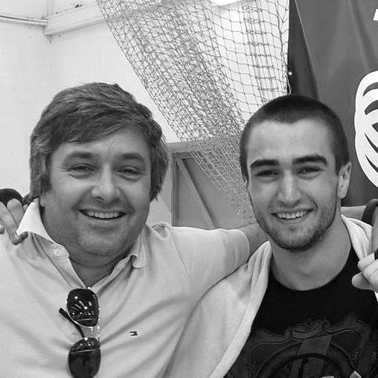
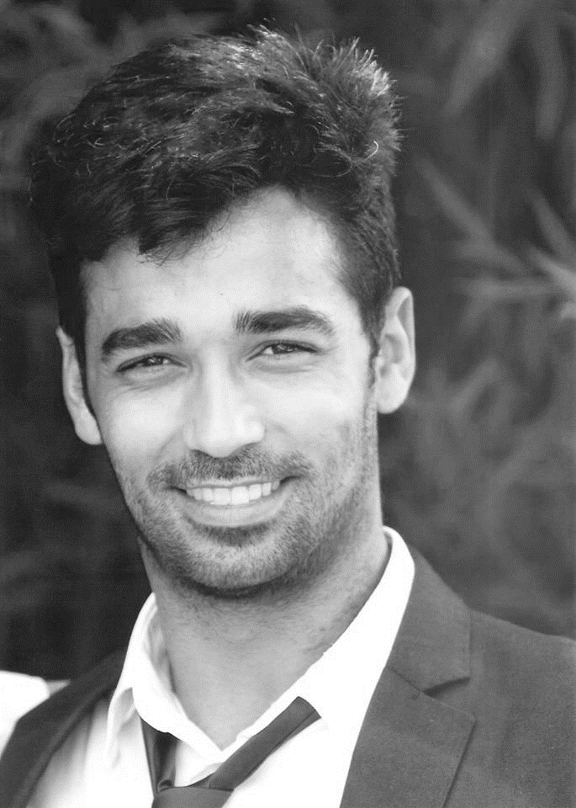
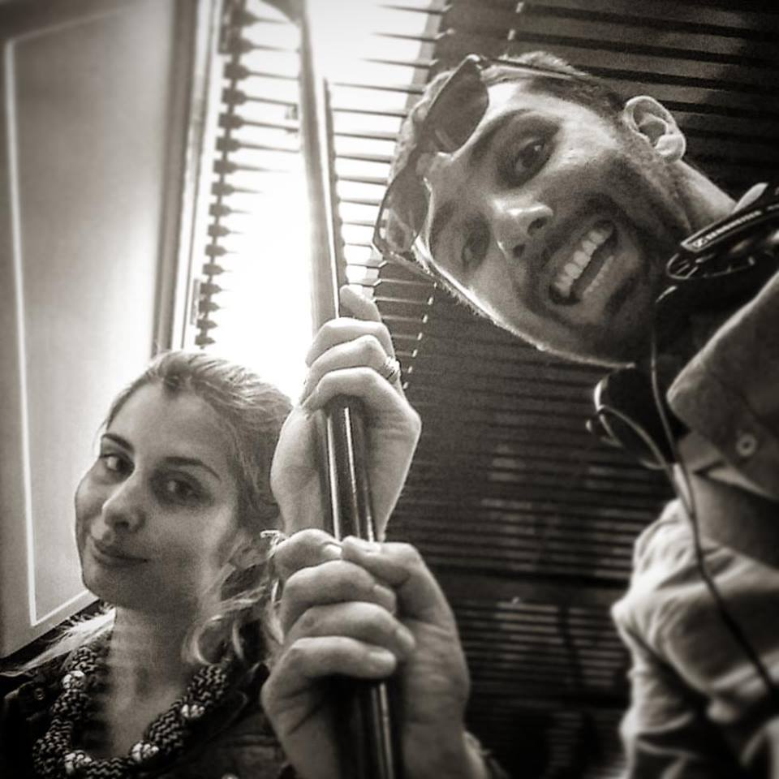

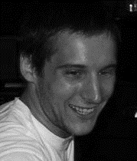
The OLA team
Sara Eloy, PhD
Miguel Sales Dias, PhD
Filipe Gaspar, MSc
Lázaro Ourique, MSc
Tiago Pedro, BArch
Pedro Caetano, BSc
Tiago Pedro | ISCTE-IUL, ISTAR-IUL
DCC’16 – Games for Design Research and Education
25th June 2016

Slide 7
1.1 Project Ola Objectives
This project aims to provide an answer to societal challenges by providing an innovative Organisational Life Assistant (OLA), a virtual presence that supports instrumental activities relating to daily living needs of older adults allowing them to be more independent, self-assured and to have a healthier, safer and organised life, while facilitates caregivers by supporting them on offering high-quality assistance.
Well-being advisor
Connected care organizer
Safety advisor
Every day and instrumental daily living activities memory support
Environment analysis
Multimodal interaction for elderly
Tiago Pedro | ISCTE-IUL, ISTAR-IUL
DCC’16 – Games for Design Research and Education
25th June 2016

Slide 8
1.2 motivations and the main challenge
The main challenge
Low level of expertise seniors have in ICT solutions
Multimodal HCI
Motivations
Aging population in Europe and Japan
Migration from rural to urban areas
More seniors are living alone[1],[2],[3]
Problem: High-demand for formal care systems
Tiago Pedro | ISCTE-IUL, ISTAR-IUL
DCC’16 – Games for Design Research and Education
25th June 2016

Slide 9
2.1. Pipeline
Technologies
3D space and object reconstruction
Object classification
Architectural space analysis engine
Augmented reality
Perform 3D reconstruction with RGB-D sensing (demo)
Segment and classify objects such as furniture, cables, carpets, etc (video)
Run an analysis based on architectural rules and standards
Display notifications and suggestions
Tiago Pedro | ISCTE-IUL, ISTAR-IUL
DCC’16 – Games for Design Research and Education
25th June 2016

Slide 10
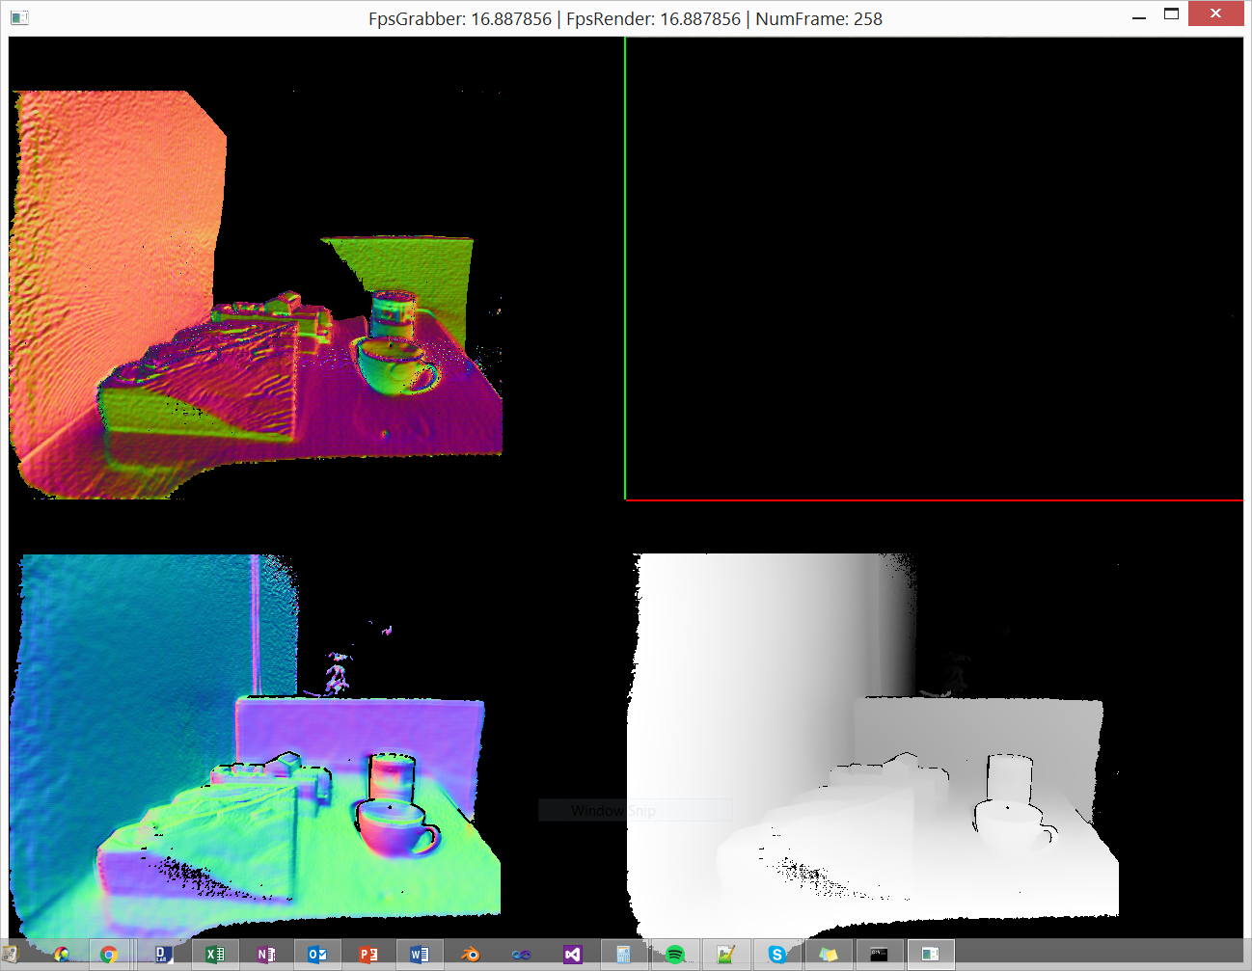
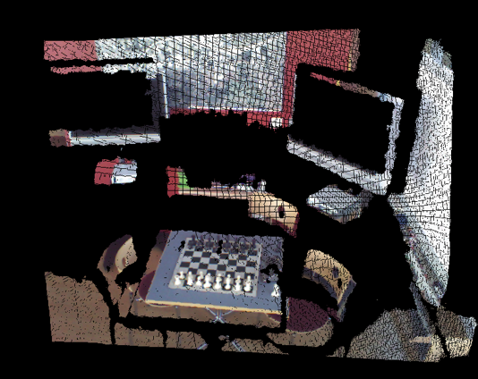
2.1. Pipeline
3D reconstruction with RGB-D sensing[1]
[1] Gaspar, F. “3D Tracking and Scene Reconstruction”. http://istar.iscte-iul.pt/index.php/ProjectsAR#3dtracking
Tiago Pedro | ISCTE-IUL, ISTAR-IUL
DCC’16 – Games for Design Research and Education
25th June 2016

Slide 11
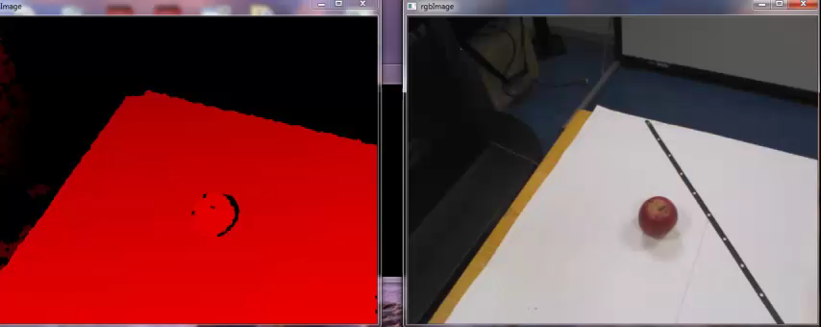
2.1. Pipeline
3D object segmentation and classification [2]
[2] Proença, P.; Gaspar, F.; Dias, M.S. “Good Appearance and Shape Descriptors for Object Category Recognition”. In International Symposium of Visual Computing, 2013.
Tiago Pedro | ISCTE-IUL, ISTAR-IUL
DCC’16 – Games for Design Research and Education
25th June 2016

Slide 12
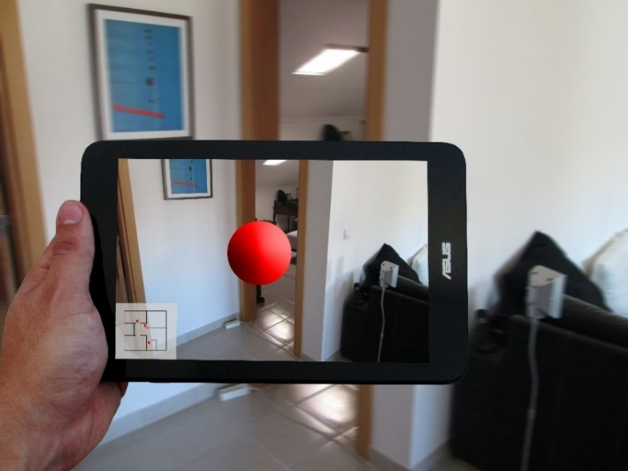
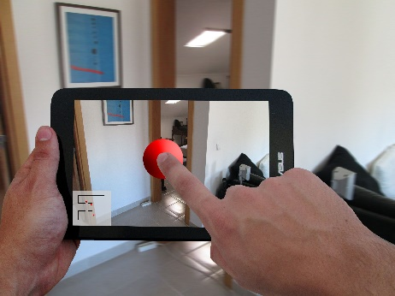
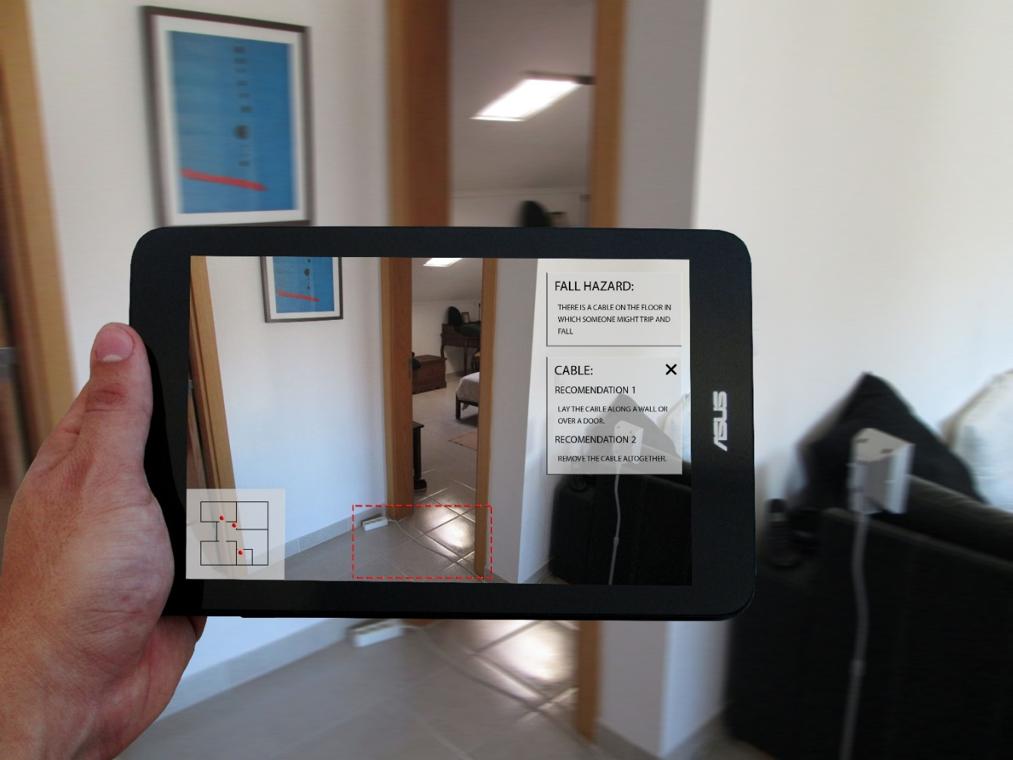
2.1. Pipeline
Display notifications and suggestions
Tiago Pedro | ISCTE-IUL, ISTAR-IUL
DCC’16 – Games for Design Research and Education
25th June 2016

Slide 13
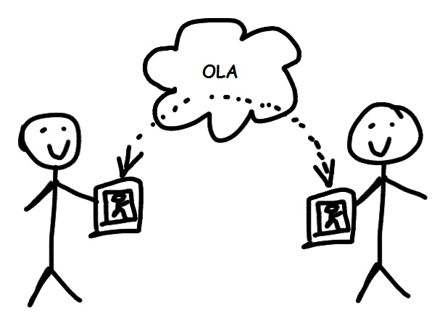
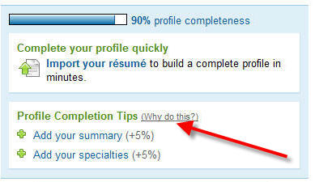
2.2. gamification
This procedure is a bore!
Very technical and not motivating
So… What about some social sharing of hazard situations and scanning completeness percentage to both raise awareness and define goals to motivate the user?
Tiago Pedro | ISCTE-IUL, ISTAR-IUL
DCC’16 – Games for Design Research and Education
25th June 2016

Slide 14
Organisational life assistant
Thank you for your attention!
Any questions?

